Slide 1
Medical INSURANCE
Done by: Instructor :
Nawaf Almutairi Dr. Mejdal Alqahtani
Surayyi Alqahtani

Slide 2
Outlines of presentation
introduction
Web scribing
Regression Models
1
3
4
5
exploratory data analysis
2
6
Project goal
Conclusion

Slide 3
Intordication
insurance
Health insurance is a type of insurance that covers medical expenses that arise due to an illness.
These expenses could be related to hospitalization costs, cost of medicines or doctor consultation fees.

Slide 4

Project goal
Problem statement/ question : How can the insurance companies predict the cost for individual patients?
This project is aimed at giving the insurance companies a proximal prediction of costs for every individual.

Slide 5
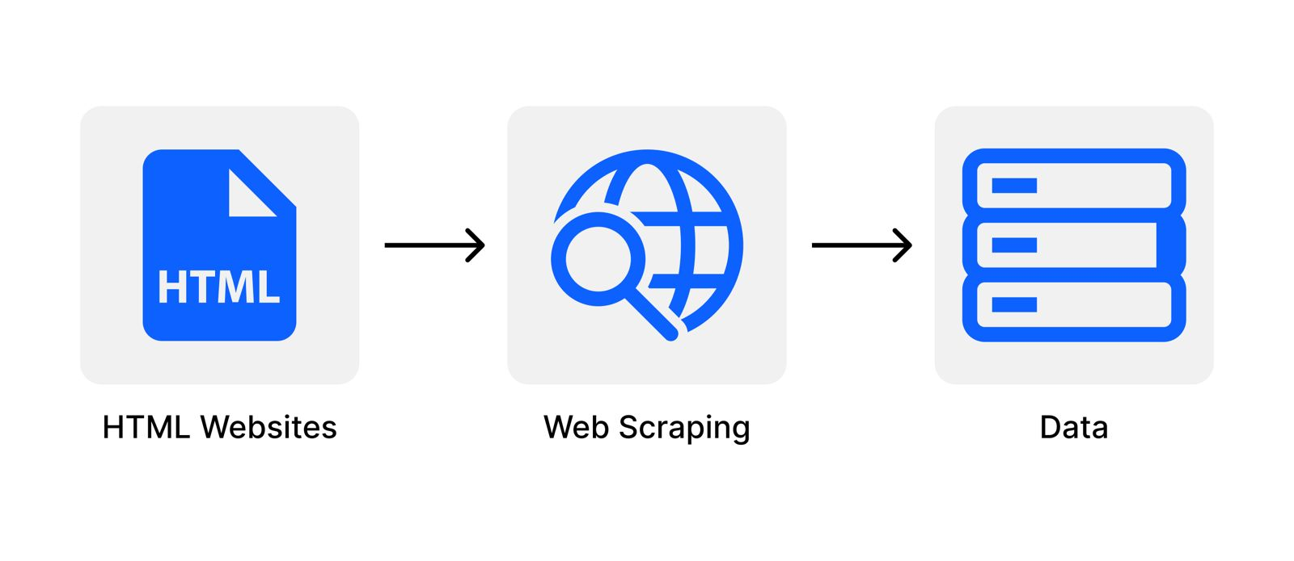
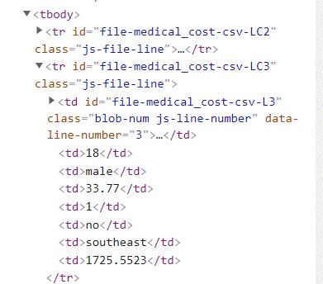
Web scribing:
Web Scribing is an automatic method to obtain large amounts of data from websites. Most of this data is unstructured data in an HTML format.
The data was collated by using Web scribing on GitHub web page.
Using Beautiful Soup and requests libraries.
Problem that we face.

Slide 6
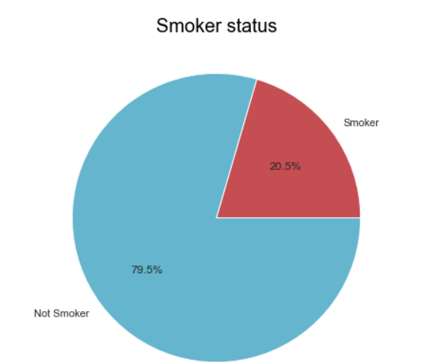
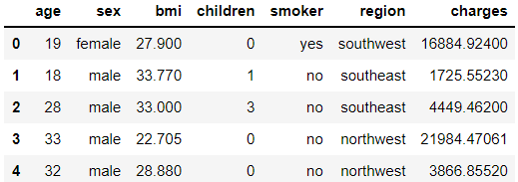
exploratory data analysis
Data Structure:
It is consisted of 7 columns and 1338 rows.
df.head( )

Slide 7
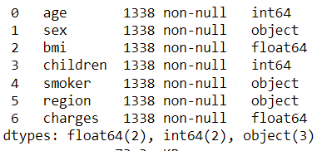
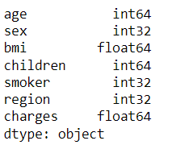
exploratory data analysis
Dummy Variables :
By using the label encoder from sklearn.preprocessing.
Before: After:

Slide 8
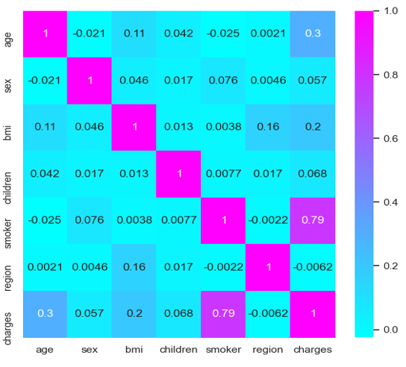
exploratory data analysis
Heat Map :
The highest impact on the charges.
Smoking.
Age.
Body Mass Index (BMI).

Slide 9
Regression Models
Regression is the relationships between a dependent variable (y) and one or more independent variables (x).
Different types of regression :
Linear Regression.
Ridge Regression.
Lasso Regression.
Polynomial Regression.

Slide 10
Regression Models
R-squared (R2) for each models :

Slide 11

Polynomial Regression
Polynomial is the best model:
We drop some columns such as region and gender, so we have high focus on important features to increase R^2.
The degree is (2).

Slide 12
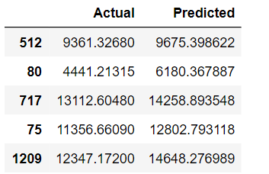
The predication
The different between actual and predicted values:
The equation: y = mx + b
y = -5325.88 + [-4.01606591e+01 5.23702019e+02 8.52025026e+02-9.52698471e+03 3.04430186e+00 1.84508369e+00 6.01720286e+00 4.20849790e+00 -9.38983382e+00 3.81612289e+00 1.40840670e+03 -1.45982790e+02 -4.46151855e+02 -9.52698471e+03]

Slide 13
Conclusion
Health insurance is a type of insurance that covers medical expenses that arise due to an illness.
Smoking has the highest impact on medical costs, even though the costs are growing with age, bmi and children.
We use some models to find the best R^2 and the Polynomial Regression turned out to be the best model.
In the future we will try to improve the R^2 and minimize the error.

Slide 14

Thenk you for lisining

